Slide 1
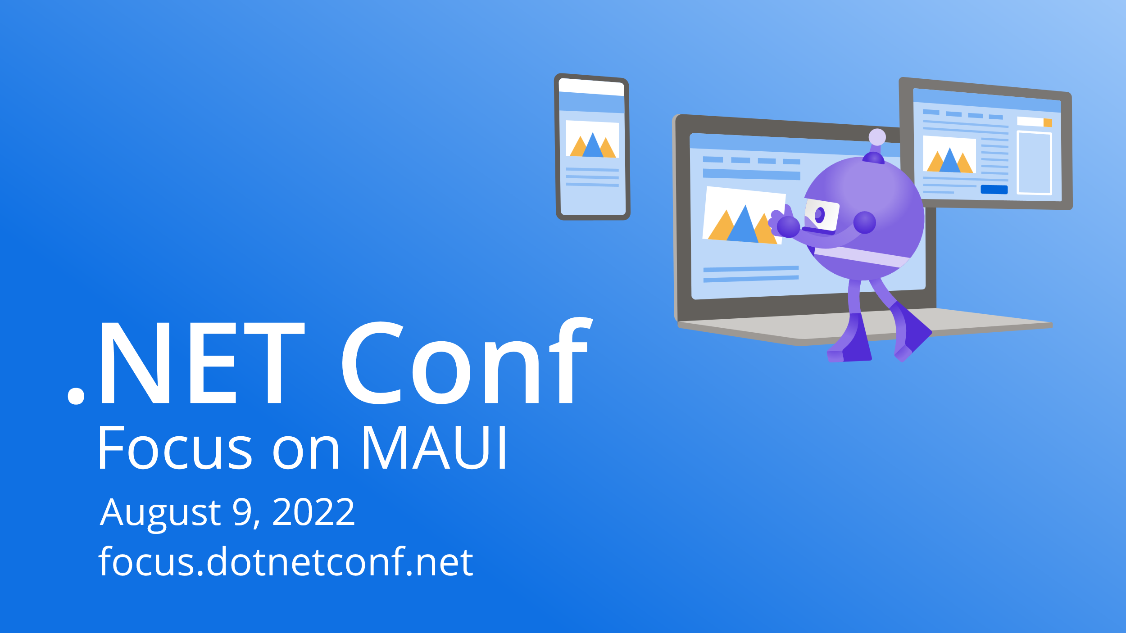

Slide 2


Unit & Integration Testing for our MAUI Applications
Allan Ritchie

Slide 3
Types of Testing
Manual Testing
Unit Testing
Integration Testing
UI Automated Testing

Slide 4
Demo
Presenter

Slide 5
Code Sample
Code sample

Slide 6
Section header

Slide 7
Announcement
Value prop 1
Value prop 2
Value prop 3

Slide 8

Thanks for joining!
Ask your questions live on Twitter #dotNETConf

Slide 9









Slide 10








Slide 11









Slide 12









Slide 13





Slide 14


Slide 15


Slide 16


Slide 17


Slide 18


